Slide 1
Муниципальное общеобразовательное учреждение средняя общеобразовательная школа № 7 города Алексеевка Белгородской области
Урок английского языка по теме:
«School clubs»
Класс: 5 «Б»
Выполнил: учитель
английского языка
Марковская М.В.
г. Алексеевка, 2013-2014 уч. год.

Slide 2
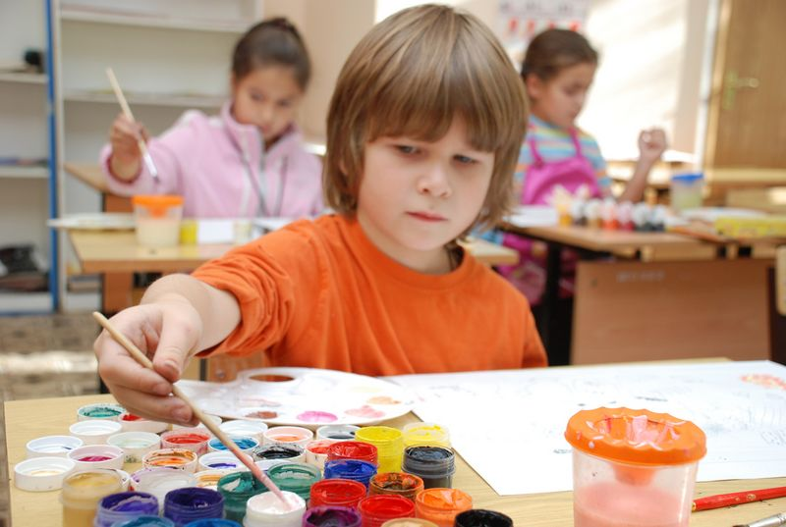
Talking about school clubs
Our school clubs invite you!

Slide 3
Find the word with the sound:
drawing
musician
[u:]
nature
singing
tennis
photography

Slide 4
Find the word with the sound:
drawing
[u:]
musician
[ʧ]
singing
nature
tennis
photography

Slide 5
Find the word with the sound:
drawing
[u:]
musician
[e]
singing
[ʧ]
nature
tennis
photography

Slide 6
Find the word with the sound:
drawing
[u:]
musician
[ɔ:]
singing
[ʧ]
nature
[e]
tennis
photography

Slide 7
Find the word with the sound:
[ɔ:]
drawing
[u:]
musician
[f]
singing
[ʧ]
nature
[e]
tennis
photography

Slide 8
Find the word with the sound:
[ɔ:]
drawing
[u:]
musician
[ɪ]
singing
[ʧ]
nature
[e]
tennis
[f]
photography

Slide 9
S
U
P
E
R
!!!
[ɔ:]
drawing
[u:]
musician
[ɪ]
singing
[ʧ]
nature
[e]
tennis
[f]
photography

Slide 10
Make up questions. Use the words from the table:
Do you like | playing the guitar?
 | travelling?
 | playing chess?
 | growing exotic plants?
Did you choose | the Musicians’ Club?
 | the School Theatre?
 | the Computer Club?
 | the Dancing Club?

Slide 11


Ex.93 p.30:
Listen and say what Dima wants to do after classes?
Choose the right variant:
play football
make a wall newspaper about their school clubs
choose the club

Slide 12
Ex.94 p.30:
Put the sentences of the dialogue in the correct order (1-4).
- That’s very interesting! Can I join you?
- Sorry, Jim. I can’t today. I promised Katya and Lena I’d make a wall newspaper about our school clubs.
- Of course, Jim. Then you can choose a club.
- Dima, would you like to play football after classes today?
Listen and check the order.

Slide 13
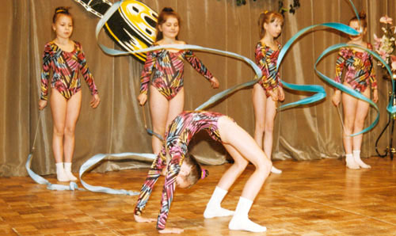
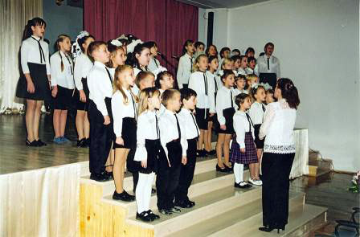
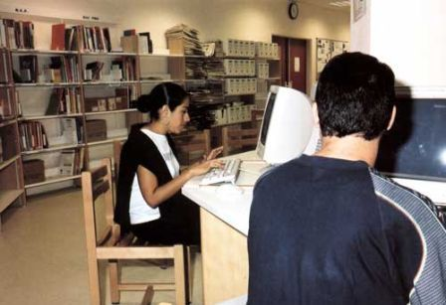
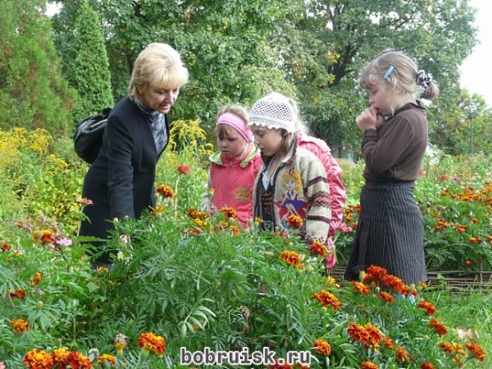
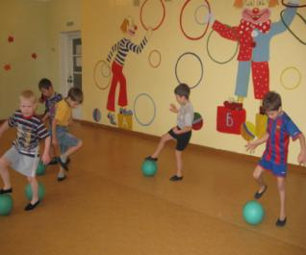
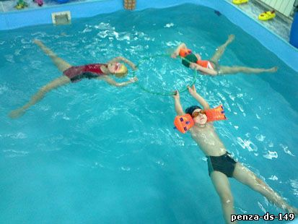
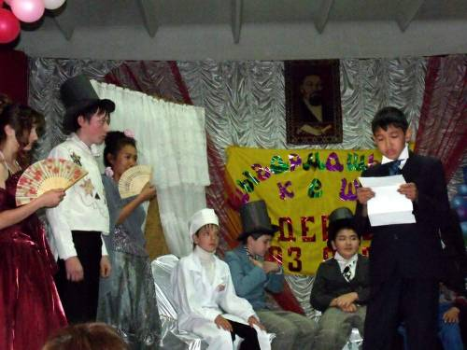
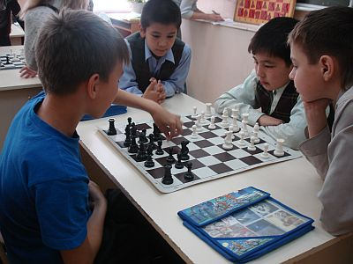
Our school clubs invite you!
1
2
3
4
5
6
7
8
9

Slide 14
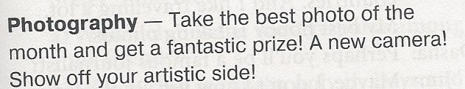
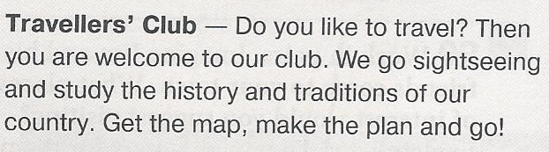
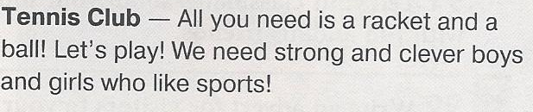
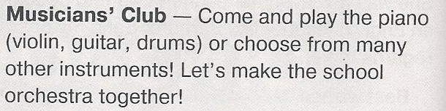
Here are more clubs. Read about them.

Slide 15
Which club would you like to choose?
1
2
3
4
5
6
7
8
9

Slide 16
Why do we attend different school clubs?

Slide 17
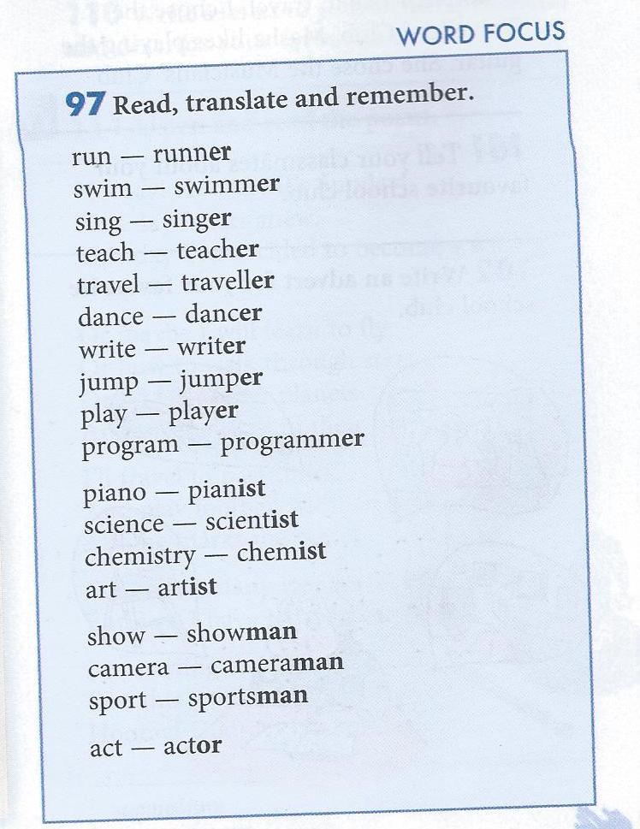
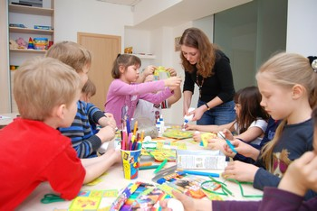
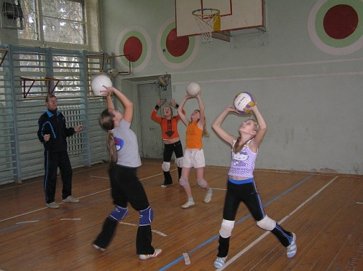
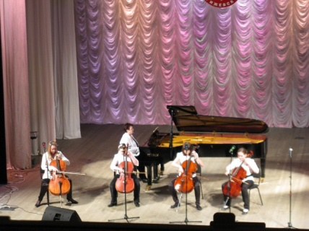
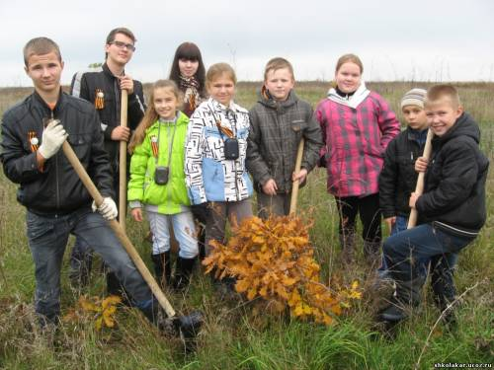

Slide 18
Write an advert for your favourite school club
Use the texts on p.30 if necessary

Slide 19
Homework:
SB: ex.97 p.31 by heart;
WB: ex.20, 21 p.11

