Slide 1
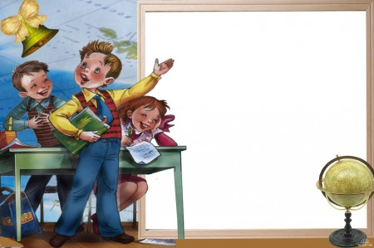
have to - must
Френдак Галина Емельяновна, учитель английского языка Копьёвской средней школы

Slide 2
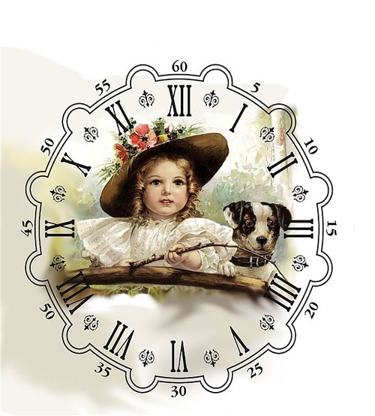
Learn
“Tick”, the clock says,
“Tick, tick, tick,
What you have to do
Do quick”.

Slide 3
Употребление have to
необходимо что – то сделать в силу определенных обстоятельств
I have to get up at 7 o’clock in the morning. (уроки начинаются в 8 часов)
He has to be in a hurry not to miss a train. (поезд уходит по расписанию)

Slide 4
I have to
We have to
You have to
They have to
He has to
She has to
It has to

Slide 5
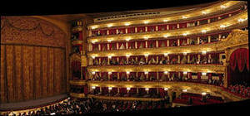
Утвердительное предложение
We have to be in
the theatre on time.
Мы должны быть в театре вовремя.
Модальный глагол
Смысловой глагол
Второстепенные члены
Подлежащее

Slide 6
Let’s practice
1. I … to come home at 5 o’clock.
2. My mother … to clean the floor every day.
3. We … to learn English.
4. My friends … to write a test.
5. They … to speak French to their guests from France.
6. He … to buy ticket for the train.
have
have
have
have
has
has

Slide 7
Отрицательное предложение
You don’t have to pay for the book, it is a present.
Тебе не нужно платить за книгу, это подарок.
do/ does
Подлежащее
Второстепенные члены
Модальный глагол
Смысловой глагол
not

Slide 8
Let us practice
1. My granny … have to work.
2. I … have to go now.
3. We … have to play football in winter.
4. Dan … have to see a doctor.
5. They … have to translate the text in pen.
don’t
don’t
don’t
doesn’t
doesn’t

Slide 9
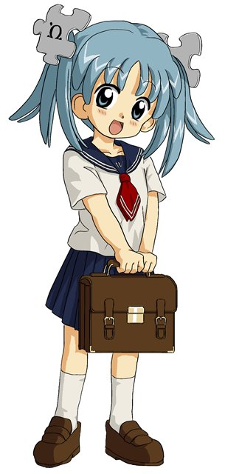
Общий вопрос
Do you have to go to school tomorrow?
Does she have to go to school tomorrow?
Подлежащее
Модальный глагол
Смысловой глагол
Второстепенные члены
Do/
does

Slide 10
Let us practice
… you have to buy a ticket?
… you have to go to school tomorrow?
.. he have to answer this question?
… they have to put on warm coat in winter?
… she have to read history for tomorrow lesson?
Do
Do
Does
Will
Will

Slide 11
Альтернативный вопрос
Do you have to go to school or hospital tomorrow?
Does he have to speak English or French?
or
or
or
Подлежащее
Смысловой глагол
Второстепенные члены
Do/ does
Модальный глагол

Slide 12
Let’s practice
My brother has to play football in school team.
Мой брат или мой друг должен играть в футбол за школьную команду?
Does my brother or my friend have to play football in school team?
Мой брат должен играть в футбол или баскетбол в школьной команде.
Does my brother have to play football or basketball in school team?

Slide 13
Разделительный вопрос
I have to do my homework, don’t I?
She has to play the piano, doesn’t she?
Подлежащее
Второстепенные члены
Модальный глагол
Смысловой глагол
,
местоимение
not
do/ does

Slide 14
Специальный вопрос
I have to get up at 7 o’clock tomorrow.
Who has to get up at 7 o’clock tomorrow?
When do I have to get up tomorrow?

Slide 15
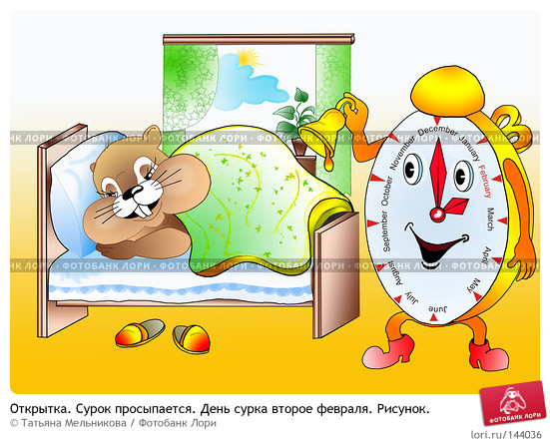
Вопрос к подлежащему
I have to get up at 7 o’clock tomorrow.
Who has to get up at 7 o’clock tomorrow?
who
Смысловой глагол
Второстепенные члены
has to

Slide 16
Let’s practice
He doesn’t have to do his homework today.
Who doesn’t have to do his homework today?
What doesn’t he have to do today?
When does he have to do his homework?

Slide 17
Употребление must
Для выражения обязанности
Для того, чтобы дать настойчивую рекомендацию
I must help my mother.
You must watch this film. It’s interesting.

Slide 18
must
I must go to school every day
You must go to school every day
He must go to school every day
She must go to school every day
It must go to school every day
We must go to school every day
They must go to school every day

Slide 19
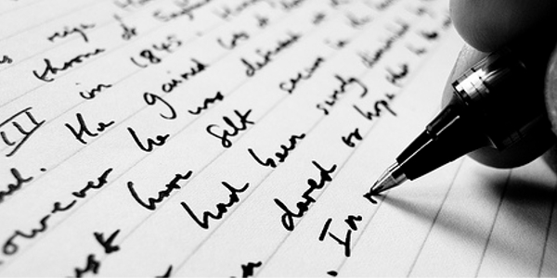
Утвердительные предложения
I must do this exercise in pen.
Подлежащее
Второстепенные члены
must
Смысловой глагол

Slide 20
Let’s practice
Ты должен прочитать эту книгу.
You must read this book.
Мой брат должен погулять с собакой.
My brother must walk the dog.
Нам нужно навестить больного друга.
We must visit our sick friend.
Мне нужно убрать в доме сегодня.
I must clean the house today.

Slide 21
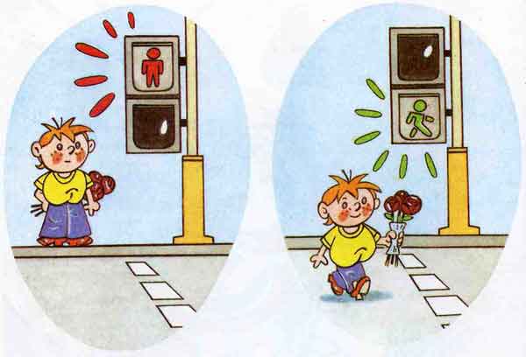
Отрицательное предложение
You mustn’t cross the street when the light is red.
Нельзя пересекать улицу на красный свет.
Подлежащее
must
not
Смысловой глагол
Второстепенные члены

Slide 22
Let’s practice
Нельзя ходить по льду, это опасно.
You mustn’t walk on the ice, it is dangerous.
Нельзя управлять машиной, если тебе 12.
You mustn’t drive the car if you are 12.
Нельзя играть на дороге, это опасно.
You mustn’t play on the road, it is dangerous.
Нельзя ходить по крыше, ты можешь упасть.
You mustn’t walk on the roof, you may fall down.

Slide 23
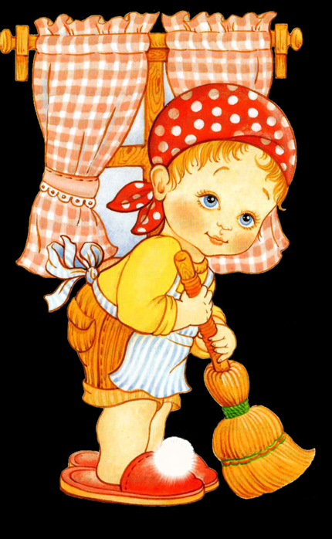
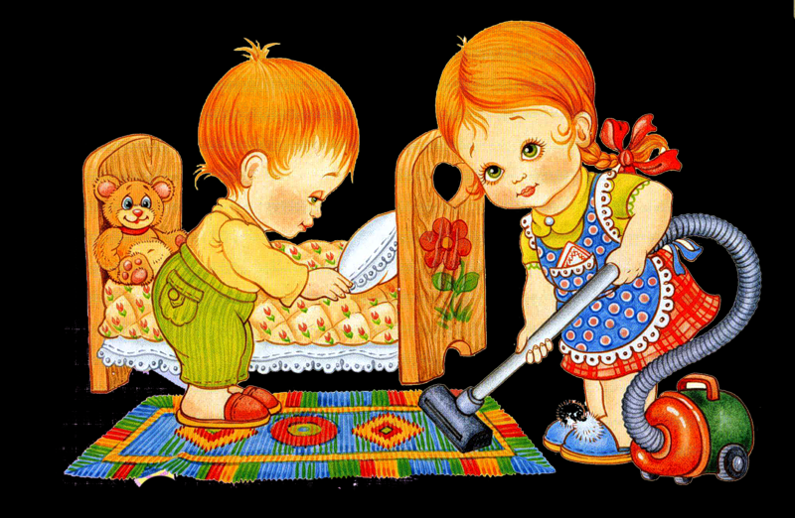
Общий вопрос
My sister must help my mum.
Must my sister help my mum?
Подлежащее
Второстепенные члены
Must
Смысловой глагол

Slide 24
Let’s practice
We must be polite with the adults.
Must we be polite with the adults?
Children must work hard at school.
Must children work hard at school?
People mustn’t drop litter in the streets.
Must people drop litter in the streets?
People mustn’t wash cars in the rivers.
Must people wash cars in the rivers?

Slide 25
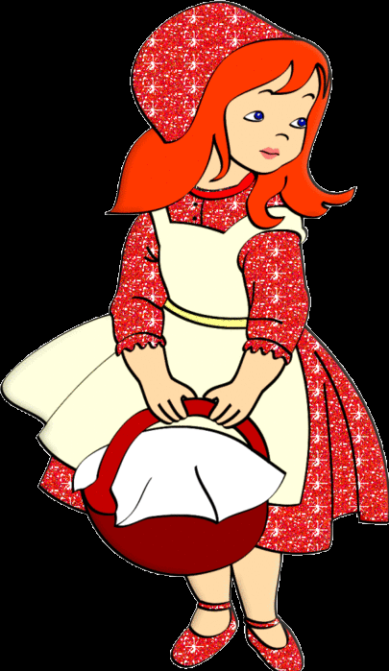
Специальный вопрос
I must visit my granny, because she is ill.
Why must I visit my granny?
Whom must I visit?
What must I do?
Подлежащее
Вопросительное слово
Второстепенные члены
Must
Смысловой глагол

Slide 26
Let’s practice
Children must study all school subjects because they will be useful for their exams.
Who must study all school subjects?
What must children study?
Why must children study all school subjects?

Slide 27
Translate into Russian
1. You must work hard at your English lessons.
2. You must learn the words.
3. Must we learn the poem today?
4. It must be very difficult to learn Chinese.
5. You must not talk at the lessons.
6. Everybody must come to school on time.
7. Don’t ring him up: he must be very busy.
8. You must not make notes in the books.
9. I must help my mother today.
10. Don’t worry! This is not important. – Not important! You must be joking!

Slide 28
must or have to
1.I … get up early today. I want to do my job.
2. He … write a test in Literature.
3. I … go, I … help mum with dinner.
4. You … watch this film, it is funny.
5. I miss a train, I … be in a hurry.
6. You … go, thin ice!
7. You … pay for this book, it is a present.
8. My granny is ill. I … visit her today.

Slide 29
must or have to (keys)
1.I must get up early today. I want to do my job.
2. He has to write a test in Literature.
3. I must go, I must help mum with dinner.
4. You must watch this film, it is funny.
5. I miss a train, I have to be in a hurry.
6. You mustn’t go, thin ice!
7. You don’t have to pay for this book, it is a present.
8. My granny is ill. I must visit her today.

Slide 30
должен
have to (должен в силу обстоятельств)
must (должен по личным причинам, я так считаю)

Slide 31
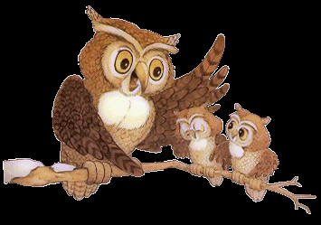
нельзя
Mustn’t (нельзя, опасно для жизни)
don’t have to (нет необходимости)

Slide 32
Использованные ресурсы
http://im1-tub-ru.yandex.net/i?id=243112704-51-72&n=21 книга в подарок
http://s44.radikal.ru/i106/1107/07/f3d980de4b7c.jpg девочка с портфелем
http://im1-tub-ru.yandex.net/i?id=144387464-10-72&n=21 просыпаться
http://www.andysowards.com/blog/assets/Practical-Tips-on-Building-a-Successful-Blog.jpeg писать
http://img1.liveinternet.ru/images/attach/b/3/20/886/20886987_44.jpg светофор
http://im6-tub-ru.yandex.net/i?id=96074554-32-72&n=21 девочка с веником
http://im2-tub-ru.yandex.net/i?id=655147518-66-72&n=21 дети убирают комнату
http://img1.liveinternet.ru/images/attach/c/3/75/878/75878591_44252553_1243241607_multpictnarod.gif красная шапочка
http://im2-tub-ru.yandex.net/i?id=175974954-41-72&n=21 театр
http://images-5.moifoto.ru/big/1/875/3744930xux.jpg?1311687371 девочка в часах
http://pravaditej.org.ua/dvigun/uploads/2010-03-18/bezdetnaja-politika_2.jpg рамка
http://img1.liveinternet.ru/images/attach/b/1/11609/11609713_2749538_golub83.gif фон звезды
http://proiectus.ucoz.ru/_si/0/s49580132.jpg сова
http://www.proshkolu.ru/content/media/pic/std/3000000/2949000/2948817-1531a5ec5846eb9e.gif сова с птенцами
http://darrellhardy.com/WordPress/wp-content/uploads/2011/02/declaration.jpg сова со свитком

Slide 33
Well
done

