Slide 1
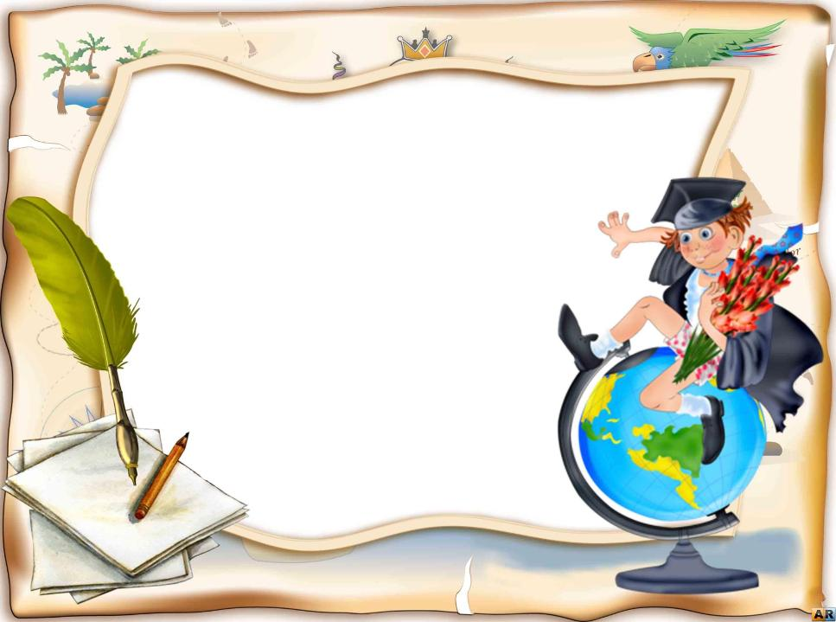
Артикль и его употребление
Радионова Анна Алексеевна
Преподаватель английского языка
ГОУ СПО Кемеровский профессионально-техничесакий техникум

Slide 2
Артикль
неопределенный определенный
The book
(определенная)
A book
(любая)

Slide 3
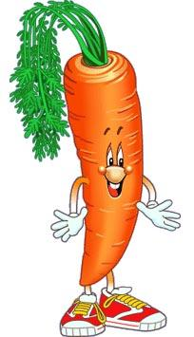
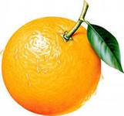
Неопределенный
An orange
A carrot

Slide 4
Неопределенный артикль:
Предмет упоминается впервые
I ate an apple for lunch.
2. В конструкции there is с исчисляемыми существительными
There is a book on the table.

Slide 5
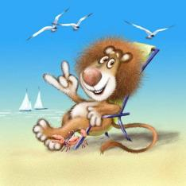
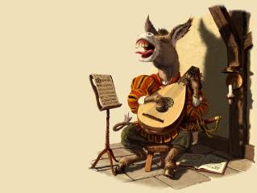
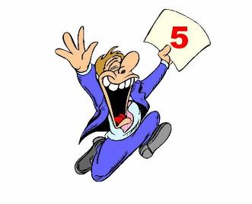
3. После «what» в восклицательных предложениях
What a day!
4. В идиомах
I am not much of a singer.
5. Именная часть составного сказуемого
I am a student.

Slide 6
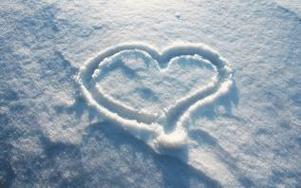
No article:
Перед абстрактными существительными
Knowledge is power.
Перед неисчисляемыми существительными
Snow is white.

Slide 7
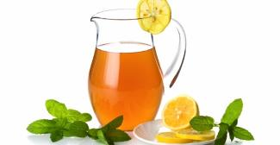
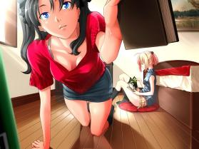
Перед количественными числительными
I bought 3 books for school library.
Перед словами “some, any, every, etc”
There is some juice in the jug.
5. Если перед словом стоит притяжательное местоимение
Her book is more expensive than mine.

Slide 8
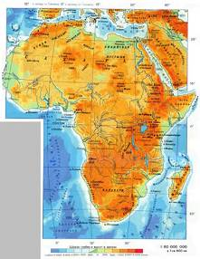
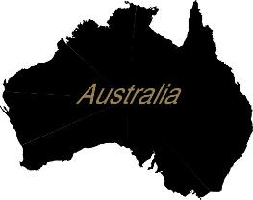
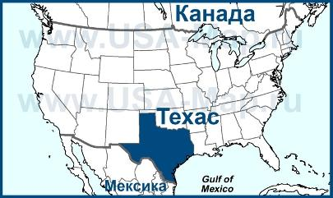
No article!
Континенты: Africa,
Штаты:
Texas

Slide 9
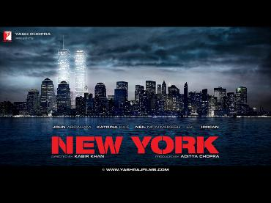
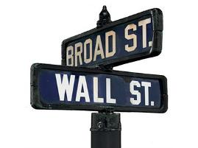
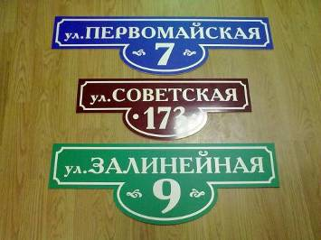
Города: New York
Abakan
Улицы:
Sovetskaya street

Slide 10
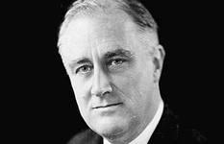
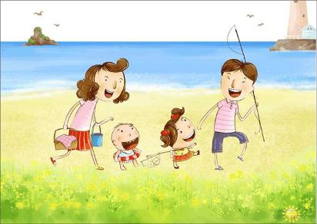
Особые случаи:
Имена людей всегда без артикля
Franklin Delano Roosevelt
НО!
Если речь идет о целой семье, используют определенный артикль
The Ivanovs, The Smiths

Slide 11
Определенный артикль всегда:
Названия океанов: The Pacific Ocean
The Atlantic Ocean
Названия морей: The Black Sea
The Baltic Sea
3. Названия рек: The Nile
The Volga
4. Названия проливов: The English Chanel
5. Названия пустынь: The Sahara

Slide 12
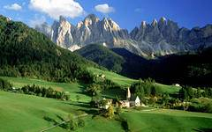
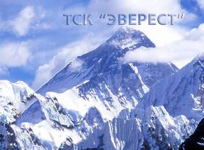
Особые случаи:
Озера: Lake Baikal (без артикля)
The Baikal
Горы: Mount Everest
The Alps

Slide 13
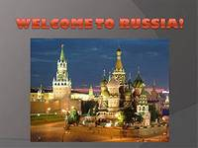
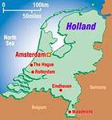
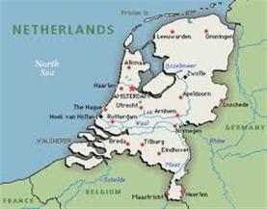
Особые случаи:
Город Гаага The Hague
Страна: Russia
The Russian Federation
Голландия: Holland
The Netherlands

Slide 14
The North
The West
The East
The South

Slide 15
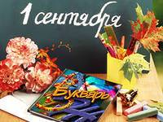
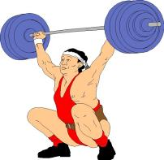
Всегда the:
с порядковыми числительными
the first of September
с прилагательными в превосходной степени
the strongest man in the city
the most beautiful girl in the class

Slide 16
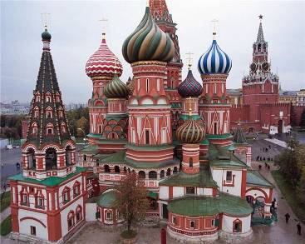
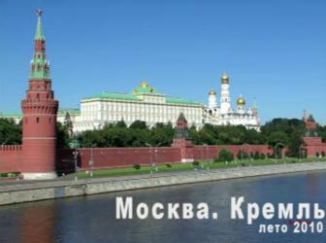
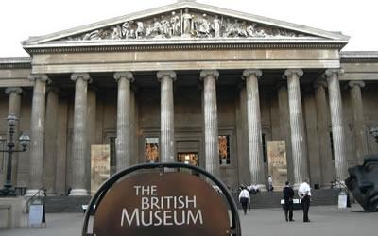
St. Basil’s Cathedral
The Tretyakov Gallery
The Kremlin
The British Museum

Slide 17
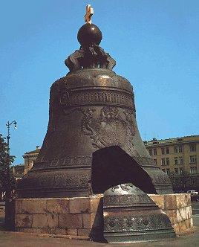
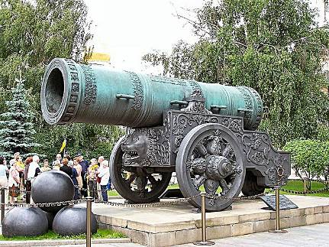
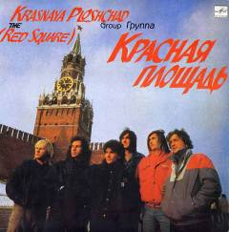
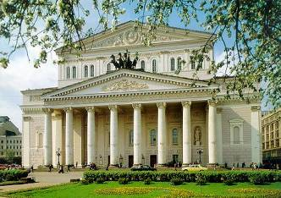
The Tsar Bell
The Tsar Cannon
The Bolshoi Theatre
Red Square

Slide 18
NO ARTICLE!
To go to school – идти в школу (учиться)
To be in hospital – быть в больнице (лечиться)
To go to bed – идти спать
To be in prison – быть в тюрьме (сидеть)
To be in church – быть в церкви (молиться)
To go to university – идти в университет (учиться)
To go to college – идти в колледж (учиться)

Slide 19
Article THE!
To go to the school – идти в школу (e.g. на родительское собрание)
To be in the hospital – быть в больнице (e.g. навестить больного)
Don’t sit on the bed – не садись на кровать (мебель)
To be in the prison – быть в тюрьме (e.g. на свидании с осужденным)
To be in the church – быть в церкви (e.g. купить свечу)
To go to the university – идти в университет (e.g. обсудить экзамены сына)
To go to the college – идти в колледж (e.g. встретить дочь)

Slide 20
Exersise1
… United States is … big country. It consists of … 50 states. … Hawaii is … 50th state. … Rhode Island is … smallest. … capital of … USA is … Washington, DC. There are … mountains in … west and big lakes in … north. … longest North American river, … Mississippi, begins near these lakes and flows into … Gulf of Mexico.

Slide 21
Keys
The United States is a big country. It consists of 50 states. Hawaii is the 50th state. Rhode Island is the smallest. The capital of the USA is Washington, DC. There are mountains in the west and big lakes in the north. The longest North American river, the Mississippi, begins near these lakes and flows into the Gulf of Mexico.

Slide 22
Exercise 2:
… New Zealand is … small country. It is situated south-east of … Australia. Nearly 3,5 million … people live in … country. … capital of … New Zealand is … Wellington. … official language is … English. …climate of … New Zealand is moist. There are … many rivers in … country. … main rivers are … Waikato and … Wairu.

Slide 23
Keys
New Zealand is a small country. It is situated south-east of Australia. Nearly 3,5 million people live in the country. The capital of New Zealand is Wellington. The official language is English. The climate of New Zealand is moist. There are many rivers in the country. The main rivers are the Waikato and the Wairu.

Slide 24
Exercise 3.
This is … book. It is my … book.
Is this your … pencil? – No, it isn’t my … pencil, it is my sister’s … pencil.
I have … sister. My … sister is … engineer. My sister’s … husband is … doctor.
I have no … handbag.
She has got … headache.
Have they got … car? – Yes, they have. Their … car is very expensive but reliable.
Have you got … calculator? – No, I haven’t.
Is this … watch? – No, it isn’t … watch, it’s … pen.
This … pen is good, and that … pen is bad.
I can see … pencil on your … table, but I can see no … paper.

Slide 25
Keys
This is a book. It is my book.
Is this your pencil? – No, it isn’t my pencil, it is my sister’s pencil.
I have a sister. My sister is an engineer. My sister’s husband is a doctor.
I have no handbag.
She has got a headache.
Have they got a car? – Yes, they have. Their car is very expensive but reliable.
Have you got a calculator? – No, I haven’t.
Is this a watch? – No, it isn’t a watch, it’s a pen.
This pen is good, and that pen is bad.
I can see a pencil on his table, but I can see no paper.

Slide 26
Exercise 4
11. Give me … chair, please.
12. They have … dog and two cats.
13. I have … spoon in my … plate, but I have no … soup in it.
14. My … friend says he is going to be … millionaire one … day.
15. Would you like … orange?
16. Mr. Smith is … artist, Mrs. Smith is … poetess.
17. This … pencil is broken. Give me that … pencil, please.
18. She has … ball. … ball is … big.
19. I got … letter from my … friend yesterday. … letter was interesting.
20. When they were in Geneva, they stayed at … hotel and sometimes in … restaurant.

Slide 27
Keys
11. Give me a chair, please.
12. They have a dog and two cats.
13. I have a spoon in my plate, but I have no soup in it.
14. My friend says he is going to be a millionaire one day.
15. Would you like an orange?
16. Mr. Smith is an artist, Mrs. Smith is a poetess.
17. This pencil is broken. Give me that pencil, please.
18. She has a ball. The ball is big.
19. I got a letter from my friend yesterday. The letter was interesting.
20. When they were in Geneva, they stayed at a hotel.

Slide 28
Exercise 5
1.He hasn’t got … car. But he’s got … computer. … computer is new.
2. My … friends have got … cat and … dog.
3. This is … tree. … tree is green.
4. I can see three … boys. … boys are playing.
5. I have … bicycle. … bicycle is black. My … friend has no … bicycle.
6. Our … room is large.
7. We wrote … dictation yesterday. … dictation was long.
8. She has two … daughters and one … son. Her … son is … pupil.
9. Last year I gave my … mother … bracelet for her … birthday. She liked … bracelet.
10. My … brother’s … friend has no … dog.

Slide 29
Keys
1.He hasn’t got a car. But he’s got a computer. The computer is new.
2. My friends have got a cat and a dog.
3. This is a tree. The tree is green.
4. I can see three boys. The boys are playing.
5. I have a bicycle. The bicycle is black. My friend has no bicycle.
6. Our room is large.
7. We wrote a dictation yesterday. The dictation was long.
8. She has two daughters and one son. Her son is a pupil.
9. Last year I gave my mother a bracelet for her birthday. She liked the bracelet.
10. My brother’s friend has no dog.

Slide 30
Exercise 6
1. This is … pen. … pen is red.
2. These are pencils. … pencils are black
3. This is … soup. … soup is tasty.
4. In the morning I eat … sandwich and drink … tea.
5. She gave me … coffee and … cake. … coffee was hot. … cake was tasty.
6. Do you like … ice-cream?
7. I see … book in your … hand. Is … book interesting?
8. Do you need … camera?
9. He never eats … meat, he always eats … vegetables, … cereals, … seeds, … fruit, and … nuts. He is … vegetarian.
10. This is … pineapple. … pineapple is delicious.

Slide 31
Keys
1. This is a pen. The pen is red.
2. These are pencils. The pencils are black
3. This is soup. The soup is tasty.
4. In the morning I eat a sandwich and drink tea.
5. She gave me coffee and cake. The coffee was hot. The cake was tasty.
6. Do you like ice-cream?
7. I see a book in your hand. Is the book interesting?
8. Do you need a camera?
9. He never eats meat, he always eats vegetables, cereals, seeds, fruit, and nuts. He is a vegetarian.
10. This is a pineapple. The pineapple is delicious.

Slide 32
артикль не употребляется: at _ school, at _ home, at _ work
Exercise 7
1. I have two … sisters. My … sisters are … students.
2. We are at … home.
3. My … brother is not at … home, he is at … school.
4. My … mother is at … work.
5. I am not … doctor.
6. I have no … sister.
7. He is not … pilot.
8. I have thirty-two … teeth.
9. He has … child.
10. She has two … children. Her children are at … school.
11. Is your father at … home? – No, he is at … work.
12. Where is your … brother? – He is at … home.

Slide 33
Keys
1. I have two sisters. My sisters are students.
2. We are at home.
3. My brother is not at home, he is at school.
4. My mother is at work.
5. I am not a doctor.
6. I have no sister.
7. He is not a pilot.
8. I have thirty-two teeth.
9. He has a child.
10. She has two children. Her children are at school.
11. Is your father at home? – No, he is at work.
12. Where is your brother? – He is at home.

Slide 34
8
We have … large … family.
My granny often tells us … long … interesting … stories.
My … father is … engineer. He works at … factory. … factory is large.
My … mother is … doctor. She works at … large … hospital. She is at … work now.
My … aunt is … teacher. She works at … school. … school is good. My … aunt is not at … school now. She is at … home. She is drinking … tea and eating … jam. … jam is sweet. I am at … home too. I am drinking … tea and eating … sandwich. … sandwich is tasty.
My sister is at … school. She is … pupil.
My cousin has … big … black … cat. My cousin’s … cat has two … kittens. … cat likes … milk. … kittens like … milk too.
I am … engineer.
My … son is … pupil.
He is … good … pupil.

Slide 35
Keys
We have a large family.
My granny often tells us long interesting stories.
My father is an engineer. He works at a factory. The factory is large.
My mother is a doctor. She works at a large hospital. She is at work now.
My aunt is a teacher. She works at school. The school is good. My aunt is not at school now. She is at home. She is drinking tea and eating jam. The jam is sweet. I am at home too. I am drinking tea and eating a sandwich. The sandwich is tasty.
My sister is at school. She is a pupil.
My cousin has a big black cat. My cousin’s cat has two kittens. The cat likes milk. The kittens like milk too.
I am … engineer.
My son is a pupil.
He is a good pupil.

Slide 36
9
1. I see ... bottle of ... pineapple ... juice on ... kitchen table.
2. Her ... son has ... great ... sense of ... humor.
3. There was ... disco at ... club last Saturday but he didn't go.
4. Is there ... bus stop near this building?
5. We have ... big dog. ... dog is very clever.
6. My friend has ... very good computer.
7. This ... boy is big. He is ... student.
8. There is ... very large piano in the hall.
9. This is ... tree and that is not ... tree. It's ... bush.
10. I am ... boy. I am ... pupil. I study at ... school.
11. My sister is at ... work. She is ... secretary. She works at ... large office.
12. This is ...very difficult question. I don't know ... answer to it.
13. Do you see ... little girl with ... big ball in her hands? She is ... pupil of our school.
14. There was ... beautiful flower in this vase yesterday. Where is ... flower now?

Slide 37
1. I see a bottle of pineapple juice on a kitchen table.
2. Her son has great sense of humor.
3. There was a disco at a club last Saturday but he didn't go.
4. Is there a bus stop near this building?
5. We have a big dog. The dog is very clever.
6. My friend has a very good computer.
7. This boy is big. He is a student.
8. There is a very large piano in the hall.
9. This is a tree and that is not a tree. It's a bush.
10. I am a boy. I am a pupil. I study at school.
11. My sister is at work. She is a secretary. She works at a large office.
12. This is a very difficult question. I don't know the answer to it.
13. Do you see a little girl with a big ball in her hands? She is the pupil of our school.
14. There was a beautiful flower in this vase yesterday. Where is the flower now?

Slide 38
10
1.There is ... park behind ... hospital. There are ... beautiful ... trees in ... park. 2. There is ... good ... film on TV this ... evening. I am going to watch it. 3. There is ... library between ... school and ... bank. There are ... cushions on ... sofa. 6. There are ... books on ... shelf. Give me ... book, please. 7. Look into ... refrigerator. What can you see on ... shelves? - There is ... butter in ... butter dish. There is ... sausage, but there is no ... cheese. There are ... eggs and ... apples. There is ... orange, ... lemon, and ... jam in ... little vase. 8. There is ... juice in this ... cup? May I drink ... juice? 9. There are ... girls in ... yard, but I can see no ... boys. Where are ... boys? - Oh, all ... boys are playing ... football at ... stadium.

Slide 39
Использованные ресурсы
http://www.csdb.debryansk.ru/bibl6_clip_image002.jpg книга
http://cachorrofurioso.files.wordpress.com/2012/05/english-book.jpg английская книга
http://soultraveller.co.za/wp-includes/js/crop/orange-8017.jpg апельсин
http://uyanangenclik.com/resimler/harita/ulkeler/netherlands_map_small.png.jpeg Голландия
http://www.orthodoxero.eu/media/George/Ianuarie%202012/Olanda__Small_.jpg Нидерланды
http://honeybet.typepad.com/.a/6a010535952948970b0163039add5f970d-320wi роза ветров
http://www.zastavki.com/pictures/640x480/2012/Holidays_September_1_First_of_September_017365_29.jpg 1 сентября
http://stat8.blog.ru/lr/0a2413c1ee77e6541936937ba577f039 девушка
http://www.xtec.cat/~mmusson3/peses.gif силач
http://img0.liveinternet.ru/images/attach/c/1/56/12/56012265_Ruzvelt_1933.jpg Франклин Делано Рузвельт
http://d.topic.lt/Fmfir/images/picsw/122010/03/post/tn.jpg Кремль
http://img1.liveinternet.ru/images/attach/c/2/72/817/72817275_pevec_osel.jpg осел
http://www.nlib.sakha.ru/center/images/M_images/news/2013/may/image4.jpeg студент
http://forward-now.com/wp-content/uploads/2012/05/knowledge-is-power.jpg знания сила
http://luxfon.com/large/201203/9754.jpg снег

Slide 40
http://s017.radikal.ru/i434/1202/65/76eac543a9a7.jpg семья
http://trvlworld.net/uploads/posts/2010-01/1263591439_largest_lake_01.jpg озеро Байкал
http://eh08.narod.ru/picture07.jpg гора Эверест
http://st.gdefon.ru/wallpapers_original/wallpapers/3138_italiya_alpy_selo_1999x1333_(www.GdeFon.ru).jpg Альпы
http://s16.radikal.ru/i191/1002/33/2b81bbf12c78.jpg морковь
http://gotovie-prezentacii.ru/wp-content/uploads/2013/02/geografiya-1.jpg титульный слайд
http://www.freelancejob.ru/upload/565/29717167979106.jpg ёж с яблоком
http://f8.ifotki.info/org/4c2b6e8cb765cbe096757b6cf55e93cdbc81d694021714.jpg лев
http://yourchance.3dn.ru/_ph/4/2/831815775.jpg улицы в России
http://ok.ya1.ru/uploads/posts/2010-09/1284877672_art-by-fukurou-2.jpgдевушки с книгами
http://bagerovo-school.ru/wp-content/uploads/2011/05/myblog-119769-1225888584.jpg книги
http://www.greenme.it/images/stories/mangiare/altri%20alimenti/the_freddo.jpg сок в кувшине
http://img0.liveinternet.ru/images/attach/c/6/92/311/92311456_1326648924_2photo.jpg школа
http://900igr.net/datas/mkhk/Kreml-v-Moskve/0010-010-Tretjakovskaja-galereja.jpg Третьяковская галерея
http://www.klops.ru/upload/7eef199e47f3b50b8ff8ee4c97e7a28e.jpg Собор Василия Блаженного
http://www.ukstudentlife.com/Life/Entertainment/Museums/BritishMuseum.jpg Британский музей
http://www.keminfo.ru/image/upload/tykove59.jpg Нью Йорк
http://i.quto.ru/c400x300/4c230c63eb7e6.jpeg улицы

Slide 41
http://usa-map.ru/shtat/texas/texas-na-karte-ssha-s.jpg Техас
http://900igr.net/datai/geografija/Vnutrennie-vody-Afriki/0004-002-Na-formirovanie-vnutrennikh-vod-Afriki-silnoe-vlijanie-okazali-klimat.jpg Африка
http://www.art-saloon.ru/big/item_5369.jpg Австралия
http://a.pix.ge:81/c/v6pyr.jpg Царь пушка
http://s05.radikal.ru/i178/0910/da/22b4f345899b.jpg Царь колокол
http://img0.liveinternet.ru/images/attach/c/7/98/791/98791900_a062ca.png Большой театр
http://www.metalrus.ru/datas/users/14-krasnaya_ploscad_1990.jpg Красная площадь
http://www.radionetplus.ru/uploads/posts/2013-03/thumbs/1363237369_oboi-knigi-22.jpg книга на столе

