Slide 1

ГБОУ СПО МК №6 ДЗМ
Тема: « Молодежные субкультуры. Youth subcultures»
По дисциплине иностранный язык (английский)
Выполнила: Пчёлина Л.Г.

Slide 2
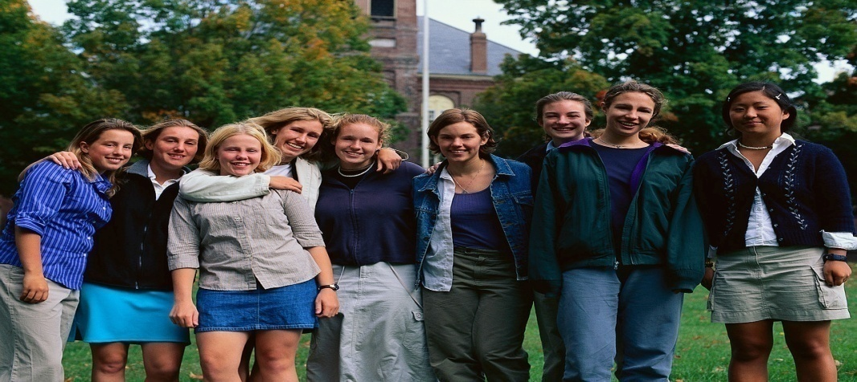
Why this presentation is useful for you
You’ll learn some new English words and word combinations on the theme “Youth subcultures“ for their further use in speaking, reading, and writing.
You’ll read the text and you will be able to use the new material in your practice.

Slide 3
Words
youth – молодежь, молодежный
subсulture - субкультурa
recent – современный, последний
fashion – мода
mainstream - общепринятый
to accept - принимать
views – взгляды
clothes – одежда
to express – выражaть
impolite - невежливый
to realize – осознать
urban - городской
Goths – готы
Punks - панки
Hippies - хиппи
Skinheads – скинхеды
“Heavy metal” - металлисты

Slide 4
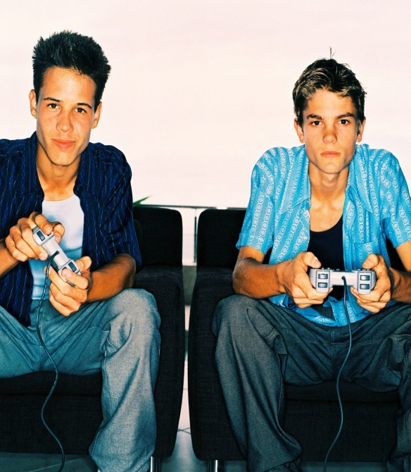
Do you know anything about urban subсultures of the youth?
It is generally held that subсulture is the сulture of those who are dissatisfied with their place in society. On the whole Teds, Mods, Ro-
ckers, Bikers, Skinheads and
Punks are the subсultures of
the politically or economically
weak segments of the society.

Slide 5

What do recent subсultures protest against?
As it known, recent subсultures reflect a refusal
to conform in post-1945 society. For example,
the subсulture of Rastafairians was based on
nostalgia for a lost world. They idealized Africa.

Slide 6

Who were Rastafairians?
Rastafairians were Afro-Caribbean immigrants
in Britain. They dreamed of golden age in Africa
before the slave traders came. They viewed
Britain as part of the Biblical “Babylon”, the land
of slavery, and Africa especially Ethiopia as the
“Promised Land”. These Rastafairians began to
wear distinctive clothes, camouflage jackets,
large hats in the red, gold and green colours of
Ethiopia and put their long, uncut hair in “dread-
locks”. They took to speaking in a special “patois” or
dialect. Rastafairians were defiant until they became a
recognized and legitimate minority group in Great Britain at the end of
the 1980.

Slide 7

What made the greatest impact on the development of urban subсultures ?
Black music which came to Britain through the
Rastafairians made its impact on urban sub-
cultures. Such types as ska, reggae and “Hip-
hop” evolved in the Caribbean and the United
States, developed in Britain during the 1970,
came to Russia in the 1990. In Britain reggae
music is held as powerful expression of
dissidents. In our country reggae is the music of
the teenagers. Many subсultures developed as a
result of music fusion of black and white cultures.

Slide 8

Can you give an example of such fusion?
Skinheads developed in the 1970 in England
out of an older cult, the Mods. They imitated
black mannerism and fashion and danced to
reggae. At the same time the white teenagers
who loved the music and copied the clothes of
the Afro-Asian immigrants were violent to them.
They wore heavy boots, jeans and braces, and
shave their hair or cut it very short. They
aggressively sought to recover a crude working
class identity which their parents’ generation had largely
abandoned. In the main, Skinheads dreamed about the revival
of the traditional working class culture. Now this movement is in
decline in Britain but it flourishes in East European countries and
Russia. The Skinheads in Great Britain were identified with extreme right
wing views.

Slide 9
What can you say about Hippies?
Hippies belonged to the opposing young people
of the late 1960. Their forms of protest
corresponded to the standards of their contem-
poraneous society. Coming against the war in
Vietnam the young Americans, who associated
themselves with Hippies, established their com-
munes. The movement spread throughout
Europe. Hippies led a primitive life in their own
countries and then moved to the East. They
rebelled against the values of their society. Their idol was
J.R.R. Tolkien, who created the fairy tale of the 20-th century.
His epic trilogy “The Lord of the Rings” became the guidelines for
Hippies.

Slide 10
What do you know about Punks?
As far as I know, Punks appeared in Britain in the
1970 as a reaction to the glamour of the pop
star world of the 1960. Punks, like the Skinheads
are regressive, but inactive and politically indif-
ferent. Their real attraction to the young has
Been their ability to insult middle aged opinion
especially among the guardians of social values.
They have done it by using vulgar language,
wearying green and pink hair, dressing in torn
clothes, mutilating their bodies with safety pins. Now
Punks are in decline in Britain but are popular in our country.
Punks, Skinheads and Rastafairians, each in their own way asserted
that they resided in a world, as they understood it, alienated by class
and race. Generally they were young people with low self respect, who did
poorly at school. Joining a gang was a means of finding a status. They opposed the
traditional world in which they were settled as fiasco elements.

Slide 11
Are there other cults within urban subculture?
Yes, there are. “Heavy metal” is one of them.
This music of failure is widely despised by those
who enjoy pop, reggae or soul. Unlike other
rebel cults the followers of heavy metal behave
them selves as victims. They wear gothic script
and grinning sculls, expression of disheartened
interests. It is known that cults arise and
disappear over periods of a decade or two. Ragga
Gothic arose in the 1980. Raggas are American
inspired. They are clothed in baseball caps, tracksuits
trousers and chunky trainers. Gothic is a blend of 1970
Punk and 1960 Hippies. “Goths” wear their hair very long
and dyed black, and dress in cheap, loose clothes. They put on
make up, looking very pale with cosmetics around the eyes. They are not
aggressive and seem to feel nostalgia for the youth culture and music of the 1960.

Slide 12
Are there other cults within urban subculture?
At the end of the 1980 Acid House was a
fashionable subculture. It fascinated thousands
juveniles who had not earlier belonged to a cult.
Acid House guaranteed fun and all night dancing
It had its own music which was another variation
on black music from America (“House Music”).
By the 1990 this movement was also in decline.
It is interesting to note that subcultures follow a
cycle. At first they shock then provoke a strong
response. As soon as the subculture gains momentum
it magnetizes youth in search of rebel unity. Many adopt
it for fun and play at rebellion in their leisure time.
The subculture rapidly ceases to express serious dissent.
In the end it becomes another recognized and colourful
part of urban culture

Slide 13
What can you say about Goths ?
As punk faded, they became a culture in their
own right. With startling white make-up, black
or purple hair, black lipstick and fingernails,
these people certainly stand out in the crowd.
They see the world as a dark place and like it
that way.

Slide 14
Fill in the blanks with missing letters and read the words
H_pp_es G_t_s P_nks

Slide 15


Copy the words and match them with the translation
Goths
Punks
Hippies
Skinheads
“Heavy metal”
subсulture
recent
fashion
to accept
views
clothes
to express
urban
youth
субкультура
готы
скинхеды
панки
хиппи
мода
современный, последний
металлисты
молодежь
городской
одежда
принимать
выражать
взгляды

Slide 16
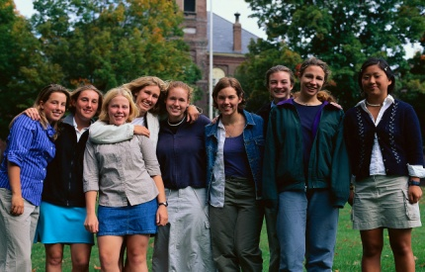
Check yourself
Goths
Punks
Hippies
Skinheads
“Heavy metal”
subсulture
recent
fashion
to accept
views
clothes
to express
urban
youth
готы
панки
хиппи
скинхеды
металлисты
субкультура
последний, современный
мода
принимать
взгляды
одежда
выражать
городской
молодежь

Slide 17
Read the texts find a title to each text among the names of groups in: Goths, Punks, Hippies, “Heavy metal”, Skinheads.
1. They are opposed to the values, norms and materialism in the society.
They express this in loud
and violent music, lyrics
which frequently contain
oppositional themes (anti
-romantic love songs, anti-parents, anti-police, etc.), strange clothing and
hair of unusual colours.
2. As punk faded, they became a culture in their
own right. With startling white make-up, black
or purple hair, black lipstick and fingernails,
these people certainly stand out in the crowd.
They see the world as a dark place and like it
that way.

Slide 18
Check yourself
1. Punks
2. Goths

Slide 19
Share your opinions on the following questions.
Would you be interested in joining any of these groups? Why / why not?
What is easier: to join a group or to leave it? Why?
3. Do you become different or stay the same when you join a group?

