Slide 1
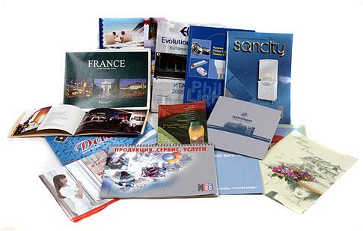
PRINT ADVERTISING

Slide 2
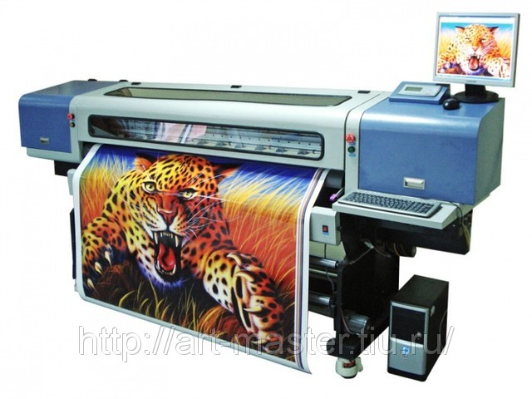
What is print advertising?
Print advertising is a form of advertising, which is made on a special printed products and is aimed, first of all, on visual perception. Printing or polygraph advertising the most widespread form of advertising all over the world.

Slide 3
Types of print advertising
Leaflets
Posters
Booklets
Prospectuses
Catalogs
Business cards
Flyers
Labels

Slide 4
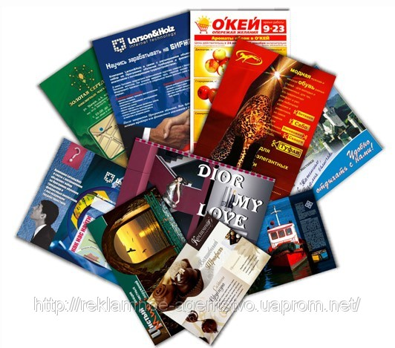
Print advertising rules
Advertisements in the press, as a rule, are laconic and short
In print advertising illustration application is very effective
It is very important to focus attention to all possible communication facilities with the advertiser

Slide 5
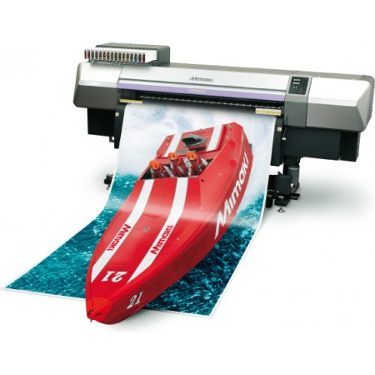
Advantages of a print advertising
Speed of manufacture
Fast modification
More deeply realize the information
Profitability
Simplicity
Using advertizing immediately

Slide 6
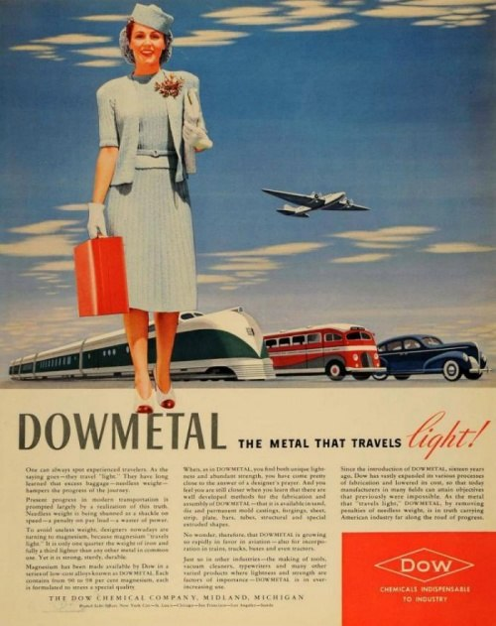
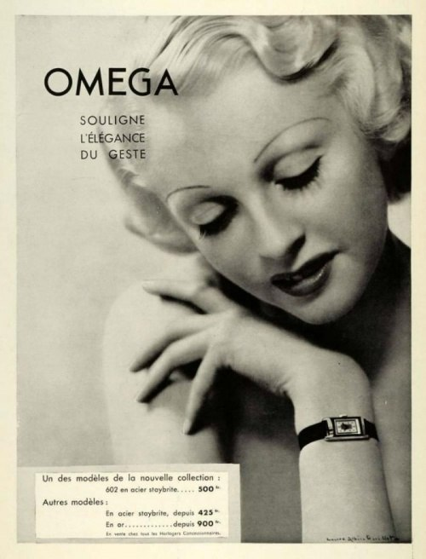
Advertising in magazines
For a long time advertisers understand how to act on the consumers through print products. They knew how to engage the viewer.

Slide 7
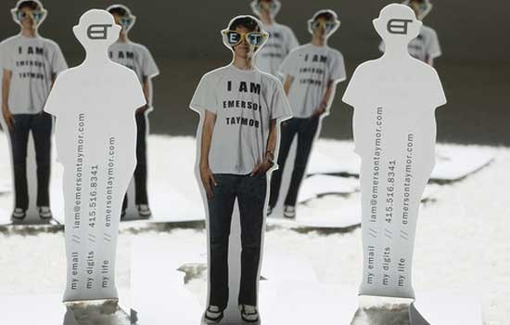
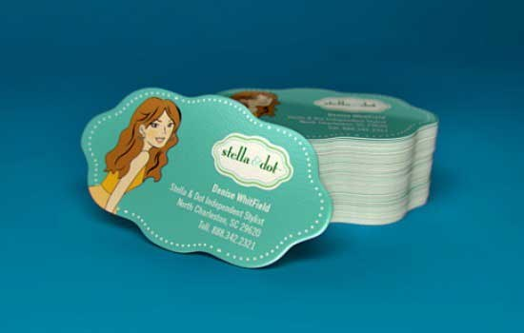
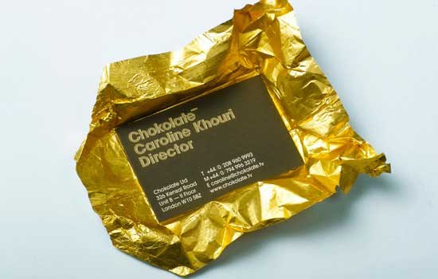
Creative business cards
There are both successful and absolutely ridiculous examples of creative business cards

Slide 8
Creative advertising posters in magazines
Examples of creative advertising posters in magazines:

Slide 9
Thank you for attention!

