Slide 1
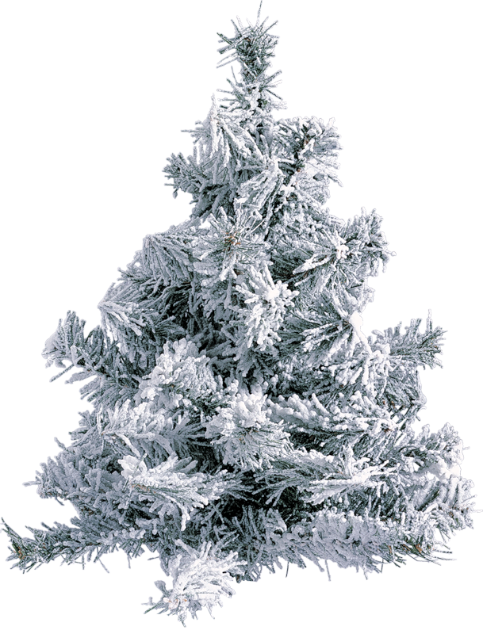
Winter - Зима
Prezented.Ru

Slide 2
begins | начинается
short | короткий
long | длинный
the weather | погода
often | часто
it snows | идёт снег
all | всё

Slide 3
is covered | покрыто
with snow | снегом
drifts | сугробы
deep | глубокие
rivers | реки
lakes | озёра
are covered | покрыты

Slide 4
animals | животные
plants | растения
sleep | спят
a good time | хорошее время
for sports | для спорта
celebrate | отмечать
Christmas | Рождество

Slide 5
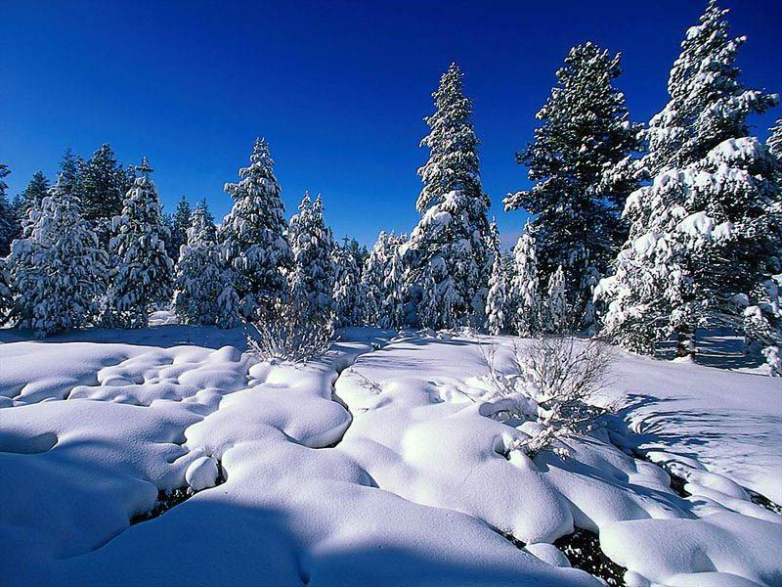
It is winter.

Slide 6
Winter months are December, January and February.

Slide 7
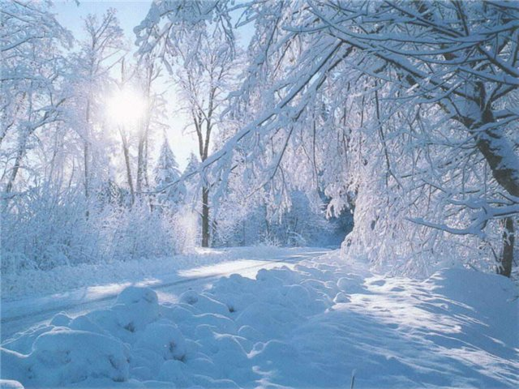
Winter begins in December.

Slide 8
Days are short.
Nights are long.

Slide 9
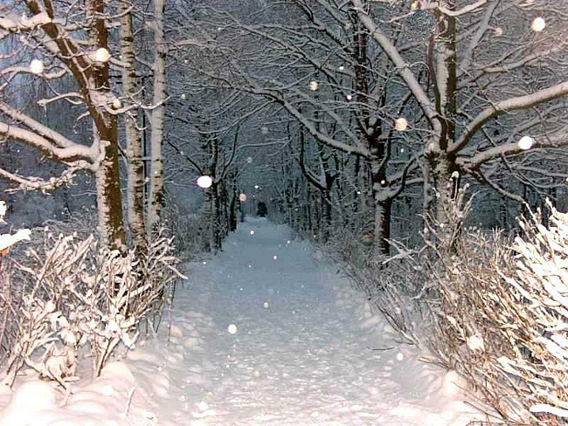
The weather is cold in winter.

Slide 10
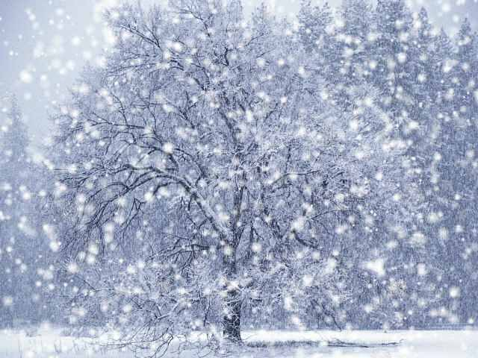
It often snows in winter.

Slide 11
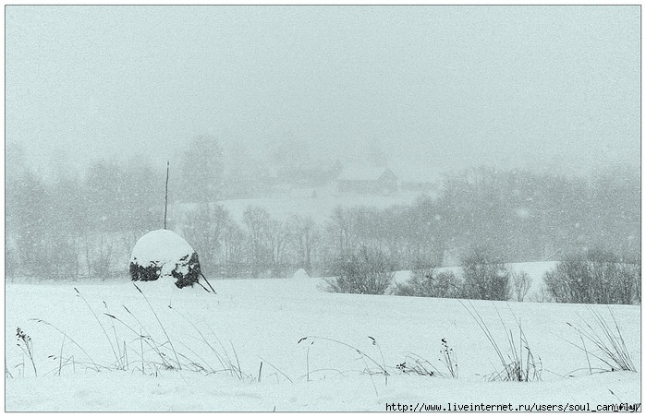
All is covered with snow.

Slide 12
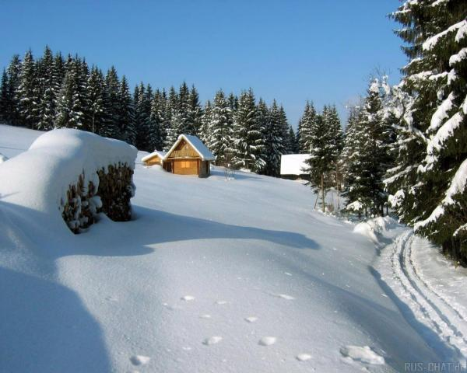
Drifts are deep.

Slide 13
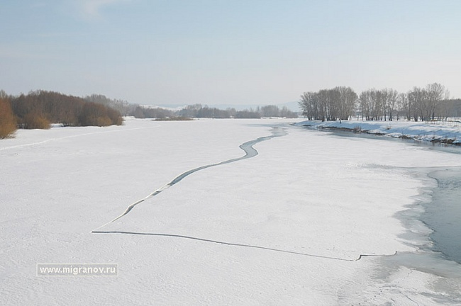
Rivers and lakes are covered with ice.

Slide 14
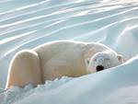
Animals and plants sleep.

Slide 15
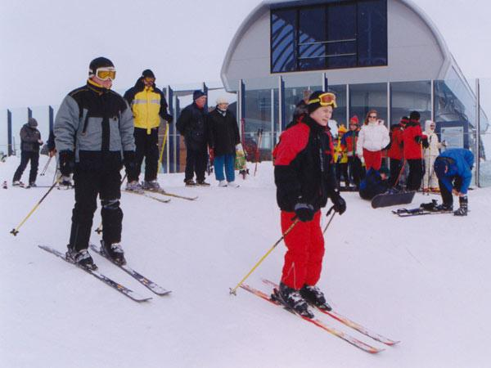
Winter is a good time for sports.
Prezented.Ru

Slide 16
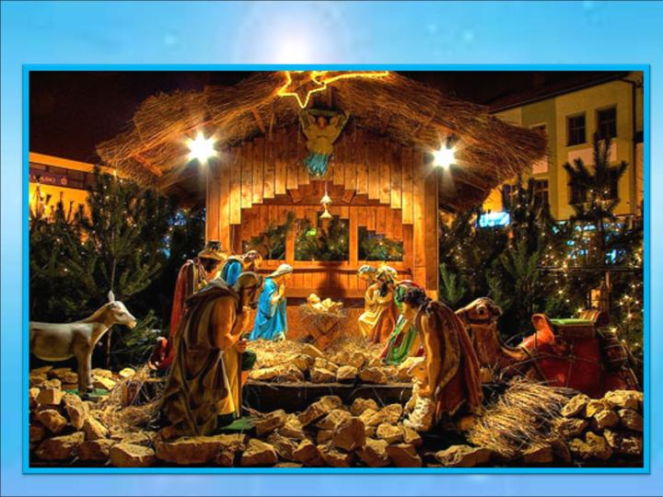
We celebrate Christmas in winter.

Slide 17
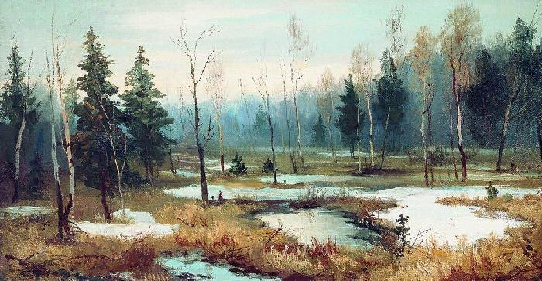
Winter ends in March.

